Slide 1

Shiny
Web development through R

Slide 2
Outline
Workshop sessions
Introduction, Structure & Basics - 10th Jan
– Widgets, images, links and how to share
More advanced elements – 17th Jan
– Layout, themes & dashboards, formatting, mapping, plots and tables
Interactivity and renderUI – 24th Jan
– Troubleshooting & “BYO-App” session

Slide 3

Session 2
Outline
Layout options
Themes & dashboards
HTML formatting
Mapping with Leaflet
Plots with plotly and ggplot
Tables with Datatable
Notes:
Focusing again on practicalities of setting up a shiny app, theory and back end is not the focus of these workshops.
More focused on results and getting the job done

Slide 4
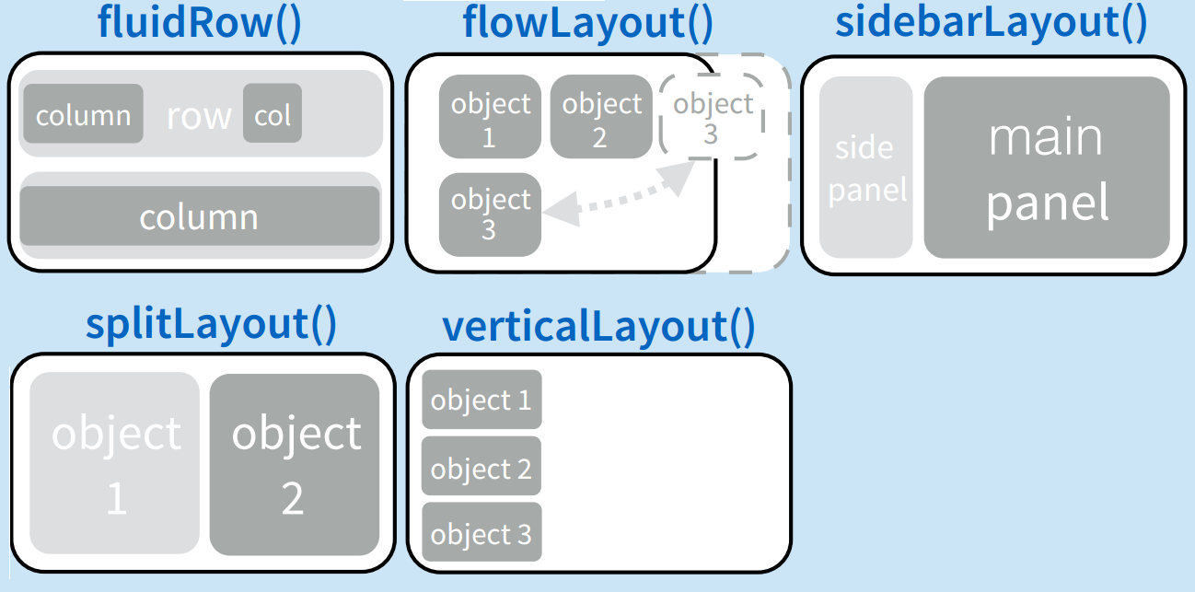
Layout
fluidPage
Most used and very flexible
titlePanel and sidebarLayout are most commonly used elements to add.
Organise panels and elements into a layout using a layout function with elements as arguments.
Combine multiple elements using different panel functions.
Can nest functions within one another.
Notes:
Other equivalents include; navbarPage(), sidebarLayout()

Slide 5
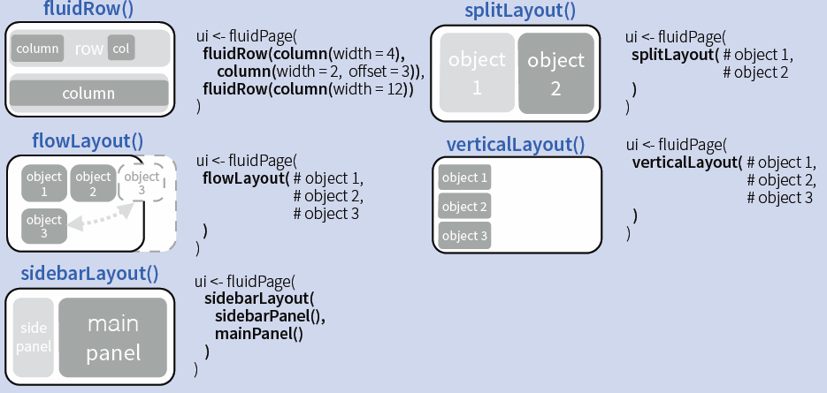
Layout code examples

Slide 6
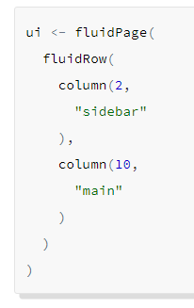
Grid system
Bootstrap 2 grid system
two types; fluid and fixed
Both use flexibly sub-divisable 12-column grid for layout
Fluid system (i.e fluidPage() also the default for other Shiny functions) always occupies the full width of the web page and re-sizes it’s components dynamically as the size of the page changes.
Create rows with fluidRow()
Create columns with column()

Slide 7
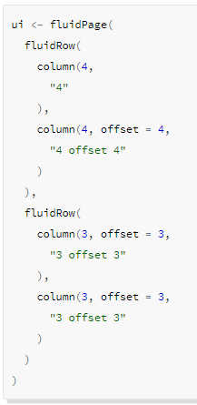
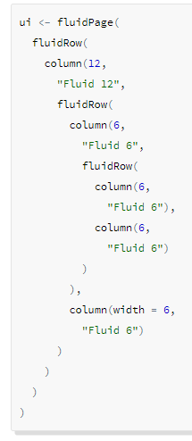
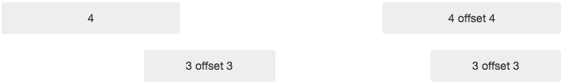
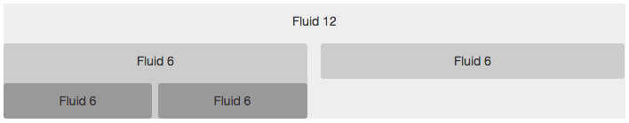
Grid system
Arrange columns using offset parameter to column()
Column nesting; each nested level of columns should add up to 12 as fluid grid uses %, not pixels.

Slide 8
Grid System
The fixed system occupies a fixed width of 940 pixels by default and the grid will also adapt to be 724px or 1170px wide when Bootstrap responsive layout kicks in (e.g. when on a tablet).
The main benefit of a fixed grid is that it provides stronger guarantees about how users will see the various elements of your UI laid out.
Using fixed grids in Shiny works almost identically to fluid grids. Here are the differences to keep in mind:
You use the fixedPage() and fixedRow() functions to build the grid.
Rows can nest, but should always include a set of columns that add up to the number of columns of their parent (rather than resetting to 12 at each nesting level as they do in fluid grids).
Notes:
i.e. if you set the first level column to equal 9 then all the level 2 columns need to total to 9 etc

Slide 9
Now you…
Create a new RStudio project, open a script and start building an app.
Explore different layouts and then build a vertical layout inside a split layout

Slide 10
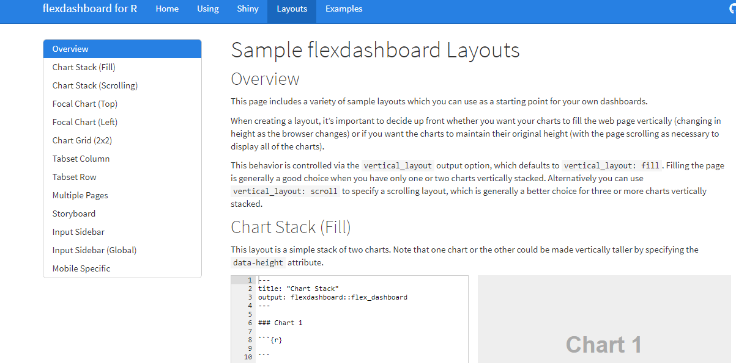
Layout
flexdashboard
R Markdown integration***
Super easy
Static or Dynamic
Slightly more restrictive in UI design
link
Notes:
If you want a more plug and play option
R markdown integrations enables auto-report generation, limited design formatting and better with only a few elements

Slide 11
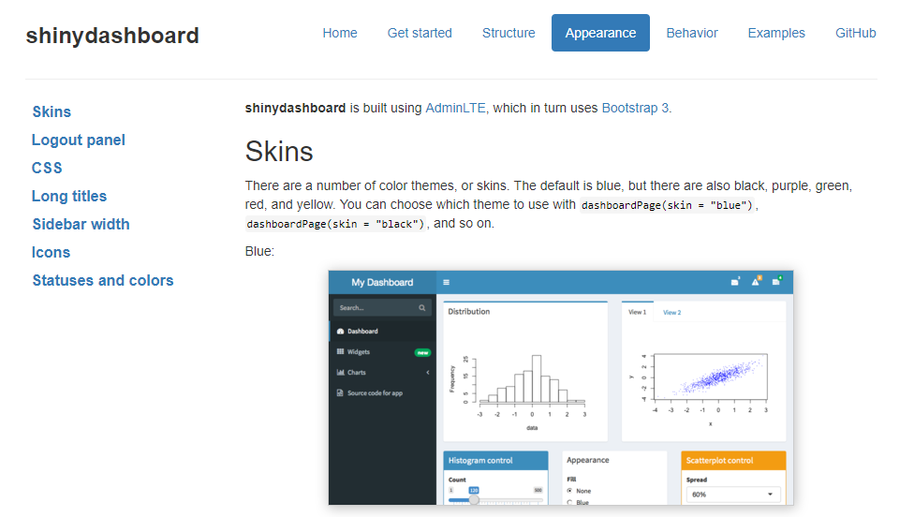
Shinydashboard – dashboardPage()
Shiny UI code, built using AdminLTE
Not quite as easy
Dynamic
Main advantages - here
link
Notes:
Not recommended unless you need one of the in-build functionalities

Slide 12
Responsive Layout
Bootstrap grid system supports responsive CSS, adapt to viewing windows/diff devices etc
Modifying width of columns
Stack elements instead of float whenever necessary
Resize headings and text to what is appropriate for device in use
To disable, use responsive = FALSE in fluidPage()
Means that small (or big) adjustments can be made in CSS
Notes:
HTML is used to create actual content of webpage
CSS is responsible for the design or style of the website colours, fonts etc

Slide 13
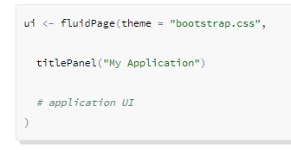
Application Themes
Bootstrap themes are typically specified using a single CSS source file (although it’s possible for them to have associated images, css, or fonts as well).
If you’ve saved a theme at the location www/bootstrap.css within your application directory then you would link it in using this code:
Bootswatch
Notes:
Shiny applications inherit the default visual theme of the Bootstrap web framework upon which Shiny is based. If you want to change the look of your application it’s possible to specify an alternate Bootstrap theme. You can do this using the theme parameter to the fluidPage(), fixedPage(), or navbarPage() function, which specifies an alternative Bootstrap CSS stylesheet to use for the application.
Download the .css file, save it and then specify it’s location within your ui
Very useful if you want to use a theme but it’s parameters clash with other elements of your app i.e. leaflet and light coloured font default for popups means text, while actually present, looks invivsible. Minor change to the .css file and resave.

Slide 14
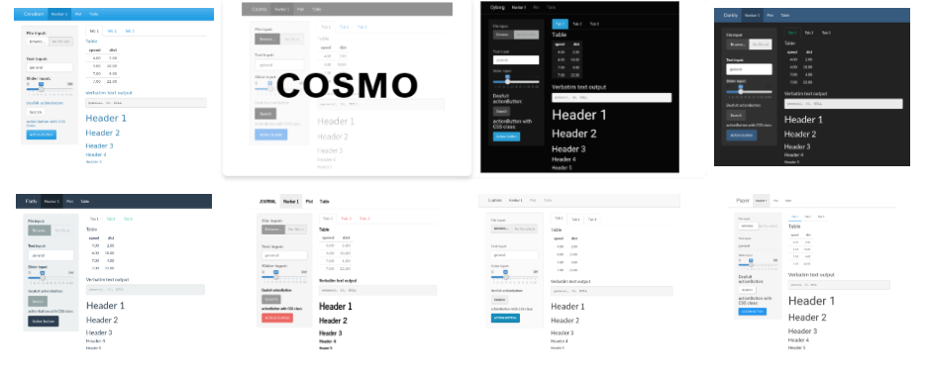
Shinythemes
https://rstudio.github.io/shinythemes/
Some options:
Notes:
Or you can use several themes already generated and accessible through the ‘theme’ argument but you specify shinytheme(“nameoftheme”)

Slide 15
Now you…
Explore some different shinythemes and choose one to add to your app.
You will need the package “shinythemes”
You can use the live theme tester to quickly preview how the different themes will look by adding themeSelector() somewhere in your ui.

Slide 16
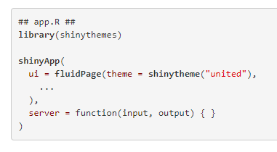
hint

Slide 17
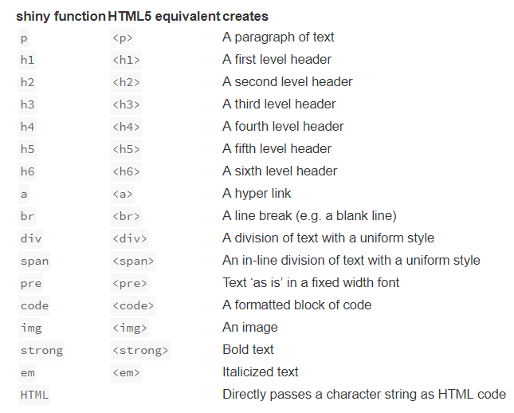
Adding content & Formatting with html
Format text using in-built tags to create Headers, alter alignment, bole/italicize, change colour etc.
Each ui object calls R functions that return HTML code
E.g.
You can also customize your UI with HTML
Shiny HTML tags glossary
titlePanel("Hello Shiny!")
## <h2>Hello Shiny!</h2>
tags$div(
HTML("<strong>Raw HTML!</strong>") )
## <div><strong>Raw HTML!</strong></div>
Notes:
Each ui object calls R functions that return HTML. In other words, Shiny lets you generate HTML with R. This is why you do not need to know HTML to use Shiny.
You can use HTML to customize your Shiny apps. Every Shiny app is built on an HTML document that creates the apps’ user interface. Usually, Shiny developers create this document by building the ui object with R functions that build HTML output. However, you can supply HTML output directly with Shiny’s tags object.
Adding characters; html site hyperlink so you can look up the appropriate wrapper tag to allow you to include unusual characters (e.g. less than or equals to sign, subscript etc)

Slide 18
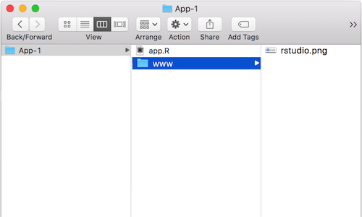
Images
‘img’ function with name of your image file as src argument
Can also include HTML friendly parameters like heights and width (numbers refer to pixels)
Img fuction looks for your image in a specific place; so your file must be in a folder named ‘www’ in the same directory as your app.r script.
So if you wanted to use an image called rstudio.png, your App-1 directory should look like this;

Slide 19
Now you…
Download and save an image of the marine institute logo from the internet and add it to your app.
Feel free to add text and other elements to jazz it up.

Slide 20
Adding links
runApp(
list(ui = fluidPage(
uiOutput("tab")
),
server = function(input, output, session){
url <- a("Google Homepage", href="https://www.google.com/")
output$tab <- renderUI({
tagList("URL link:", url)
})
})
)
HTML syntax within a block of text:
<a href="https://www.marine.ie/Home/home" target="_blank">www.marine.ie</a>
Notes:
Target=“_blank” – opens the link in a new tab, if this is removed it will open on the same page
The second link is what would appear in the text. Could be changed to “click here”

Slide 21
Now you…
Add a link to the MI webpage somewhere in your app

Slide 22

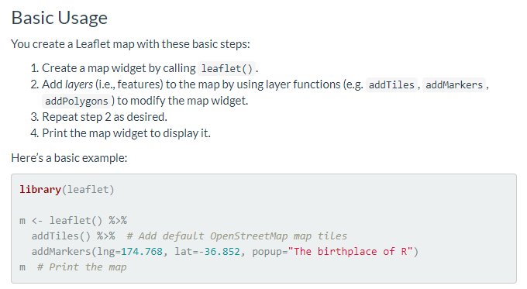
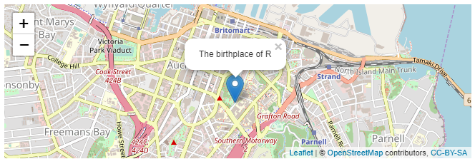
Mapping - leaflet
ui <- renderLeaflet(m)
More info: https://rstudio.github.io/leaflet/

Slide 23
Now you…
Add a map of the MI location to your app, include a marker and a pop-up label

Slide 24
Incorporating plots
ggplot
Advantages of ggplot2
consistent underlying grammar of graphics (Wilkinson, 2005)
plot specification at a high level of abstraction
very flexible
theme system for polishing plot appearance
mature and complete graphics system
many users, active mailing list
That said, there are some things you cannot (or should not) do With ggplot2:
3-dimensional graphics (see the rgl package)
Graph-theory type graphs (nodes/edges layout; see the igraph package)
Interactive graphics (see the ggvis or plotly package)
Normal ggplot code can be output as is within shiny
Normal R plotting code inside renderPlot()
Can also wrap code within plotly and gain interactivity using ggplotly() or by wrapping inside renderPlotly()

Slide 25
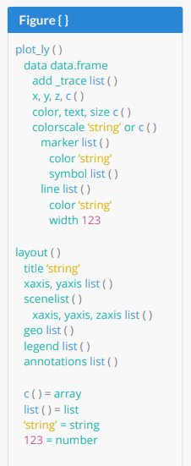
Interactive plots - Plotly
a high-level interface to the open source JavaScript graphing library plotly.js (which powers plot.ly).
Can also wrap ggplot inside renderPlotly(); this will make your plot interactive (link)
Comprehensive guide (here)
Basic code:
library( plotly )
p <- plot_ly (
x = rnorm( 1000 ),
y = rnorm( 1000 ),
mode = ‘markers’ )
P or print(p)

Slide 26
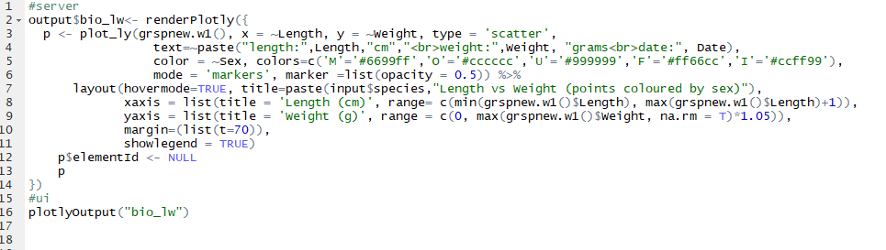
Plotly – species dashboard

Slide 27
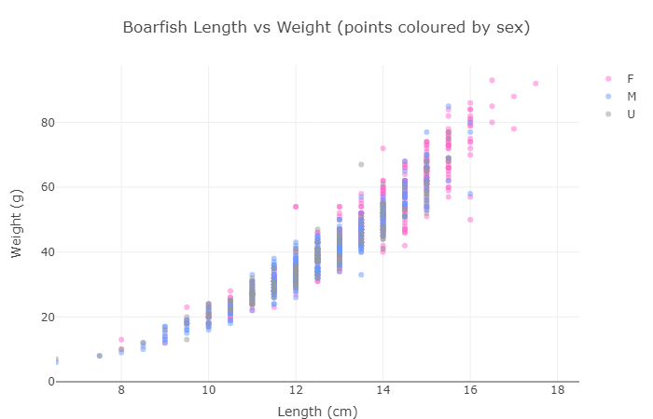
Plotly – species dashboard

Slide 28
Session 3
Outline
renderUI function, conditionalPanels,
Reactive filtering
Additional resources
App troubleshooting –BYOA (bring your own app)

Slide 29
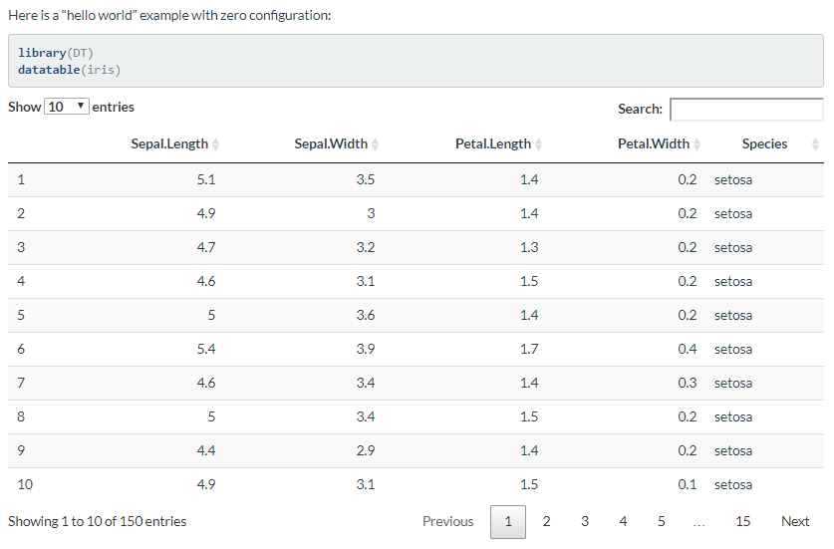
Tables - Datatable
DT: An R interface to the DataTables library
The R package DT provides an R interface to the JavaScript library DataTables
R data objects (matrices or data frames) can be displayed as tables on HTML pages, and DataTables provides filtering, pagination, sorting, and many other features in the tables
You may install the stable version from CRAN, or the development version using devtools::install_github('rstudio/DT')
The main function in this package is datatable(). It creates an HTML widget to display R data objects with DataTables.

Slide 30
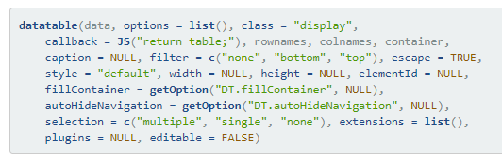
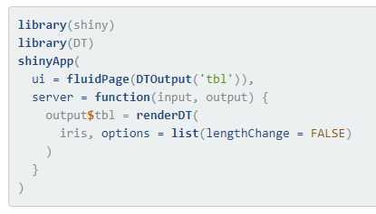
DataTables
minimal example 1
library(DT)
ui <- fluidPage(
h2("The mtcars data"),
DT::dataTableOutput("mytable")
)
server <- function(input, output) {
output$mytable <- DT::renderDataTable({
mtcars
})
}
shinyApp(ui, server)
https://cran.r-project.org/web/packages/data.table/vignettes/datatable-intro.html
More complex example/ demo of other functionalities:
https://gallery.shinyapps.io/012-datatables/
Notes:
https://rstudio.github.io/DT/

Slide 31
Reactive filtering and renderUI

Slide 32
ConditionalPanels

Slide 33
Google analytics
Google Analytics is a free service offered by Google that collects information about who visits you website and what they do while they are there.
You can learn more about Google Analytics at support.google.com/analytics, which explains how to set up and use Google Analytics with a web page.
Informatics Analytics

Slide 34
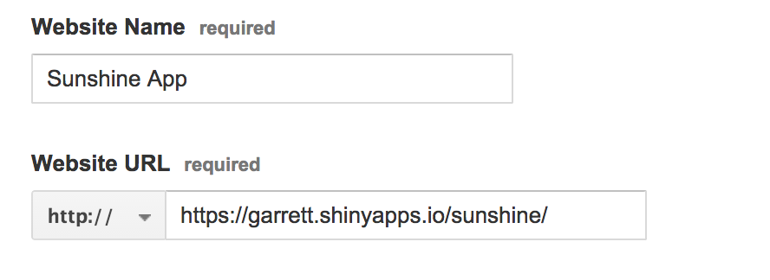
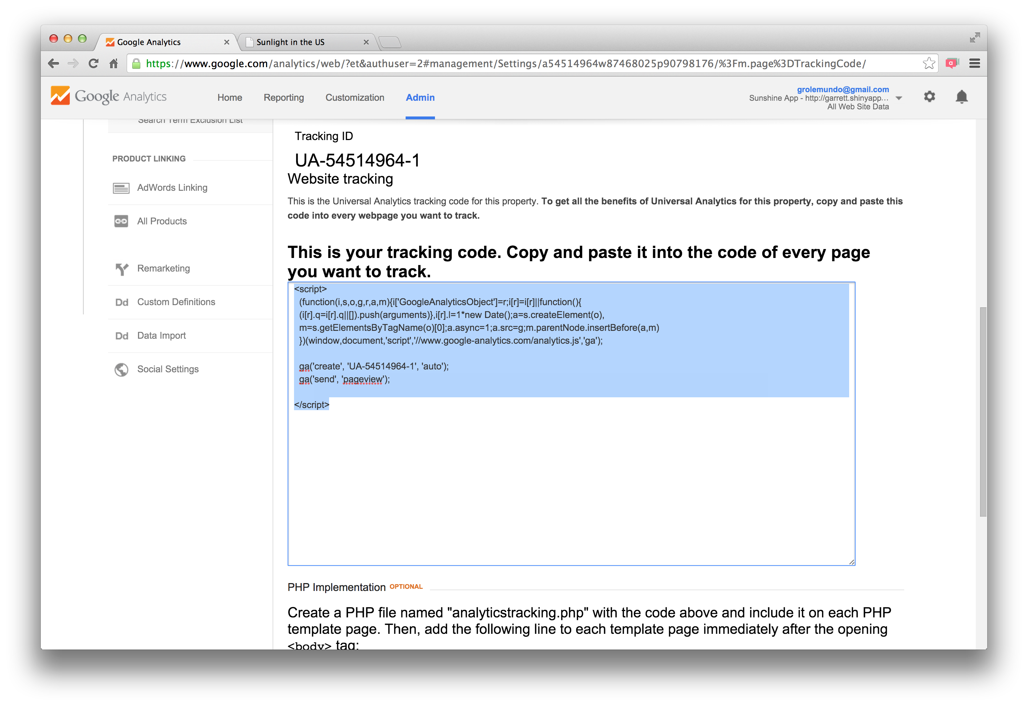
Step 1 - Create an account
To use Google Analytics, you must open a free account at www.google.com/analytics/ .
Step 2 - Add a property
Next, you must register your Shiny app as a property in your Google Analytics account. You can do this on the sign up page, or - if you already have a Google Analytics account-you can do this in the Admin tab.
Once you have entered the necessary information, click “Get Tracking ID” at the bottom of the form. Google Analytics will open a new window that contains a tracking ID number for your app as well as a short JavaScript script.
Step 3 - Embed tracking script
If you built your Shiny app with a ui.R file (the traditional method), use the tags$head and includeScript functions to include the script.

Slide 35
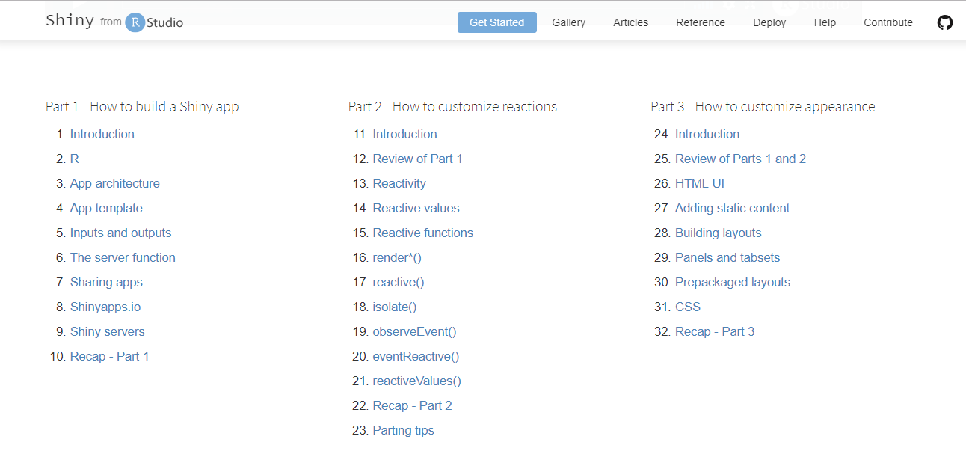
Shiny – Online tutorials
https://shiny.rstudio.com/tutorial/

Slide 36
Other Resources
https://www.rstudio.com/products/shiny/shiny-user-showcase/
https://shiny.rstudio.com/gallery/
http://gallery.htmlwidgets.org/
https://www.r-graph-gallery.com/
https://rmarkdown.rstudio.com/flexdashboard/
https://github.com/d3/d3/wiki/Gallery
http://myinspirationinformation.com/visualisation/d3-js/integrating-d3-js-into-r-shiny/
https://rstudio.github.io/promises/articles/shiny.html
http://spatial.ly/
https://flowingdata.com/category/tutorials/

Slide 37

Questions?

